Slide 1
Coursework-fullstack-blog
Author: Anatoliy Kashin
Program: B.Sc. Computer science
Matriculation Number: 9211007
Course: PROJECT: JAVA AND WEB DEVELOPMENT(DLBCSPJWD)
Tutor: Holger Klus
Date: 08.10.2023
GitHub repository link: https://github.com/AnatoliyKsh/coursework-fullstack-blog

Slide 2
Purpose of the web application
The purpose of this app is to provide a comfortable and easy-to-use blogging platform with posts, catering to a broad audience, especially focusing on influencers who wish to share their ideas and insights. However, it's not limited to just influencers, anyone can utilize it to publish their thoughts, stories, or information.
This application provides users with features that allow them to easily create and publish messages that can include both text and images. It can be easily edited or deleted.

Slide 3
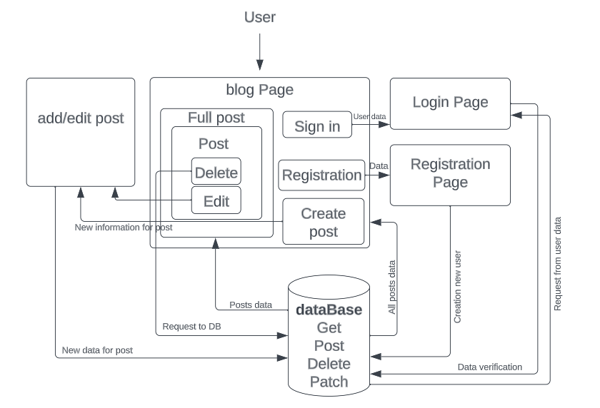
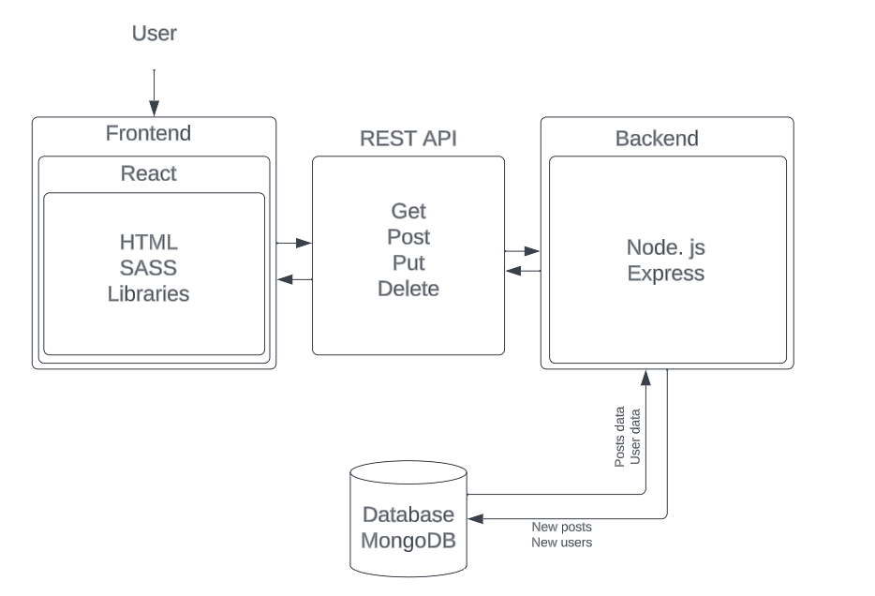
Architecture diagram
Functional chart
Technology chart

Slide 4
Technology choice
Frontend: SCSS, HTML, JSX, JS, React js, libraries: react-router-dom, redux, axios, MUI, react-markdown
Backend: Node js, JS, Express, libraries: bcrypt, mongoose
DataBase: MongoDB
The choice of a REST API architecture for this blogging platform provides a scalable and flexible solution, allowing seamless communication between the frontend and backend. Its statelessness and simplicity make it conducive to efficient data transfer, enhancing the overall performance and user experience of the application.

Slide 5
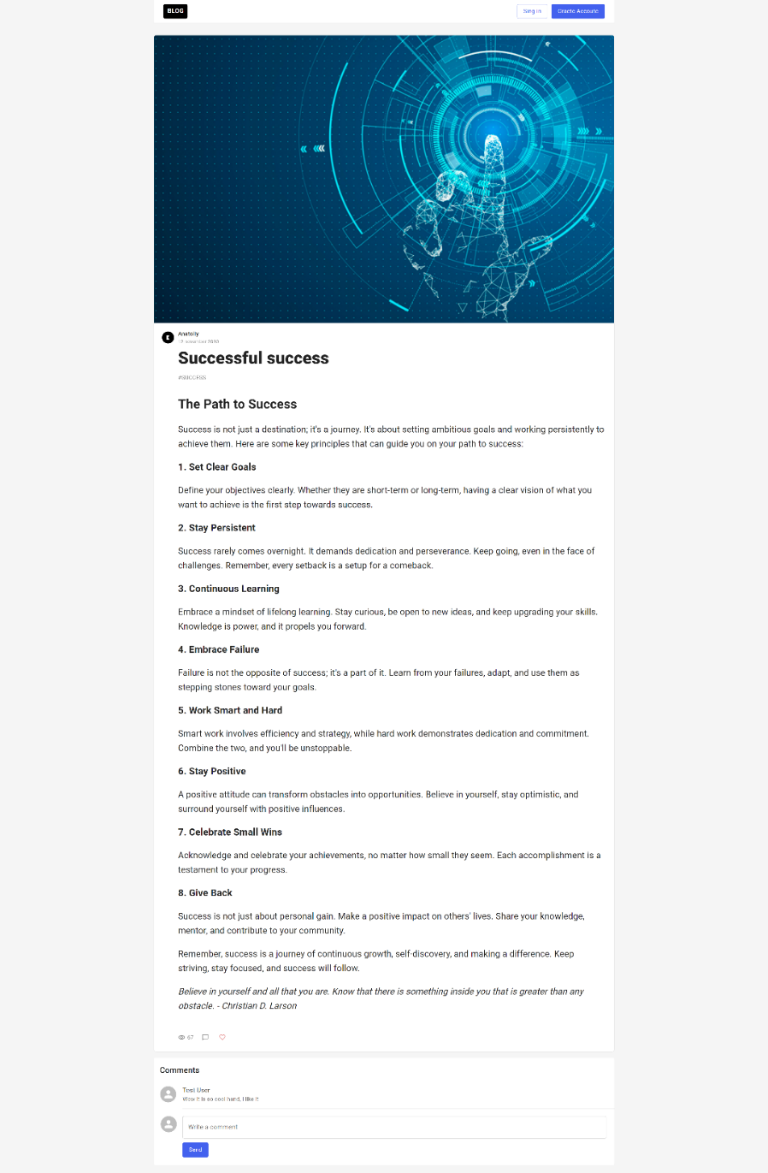
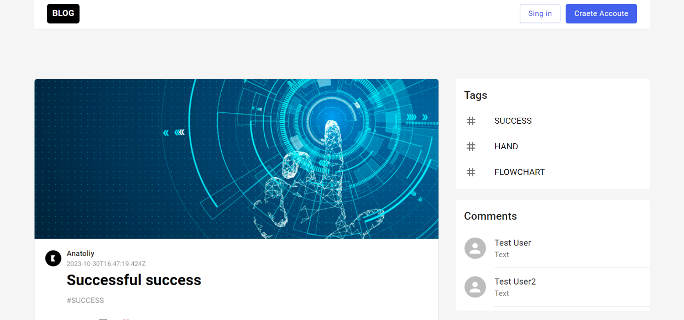
Screenshots
1
You can open the Blog page and see all published posts
You can also open the "fullPost" page with all the information in the post
2

Slide 6
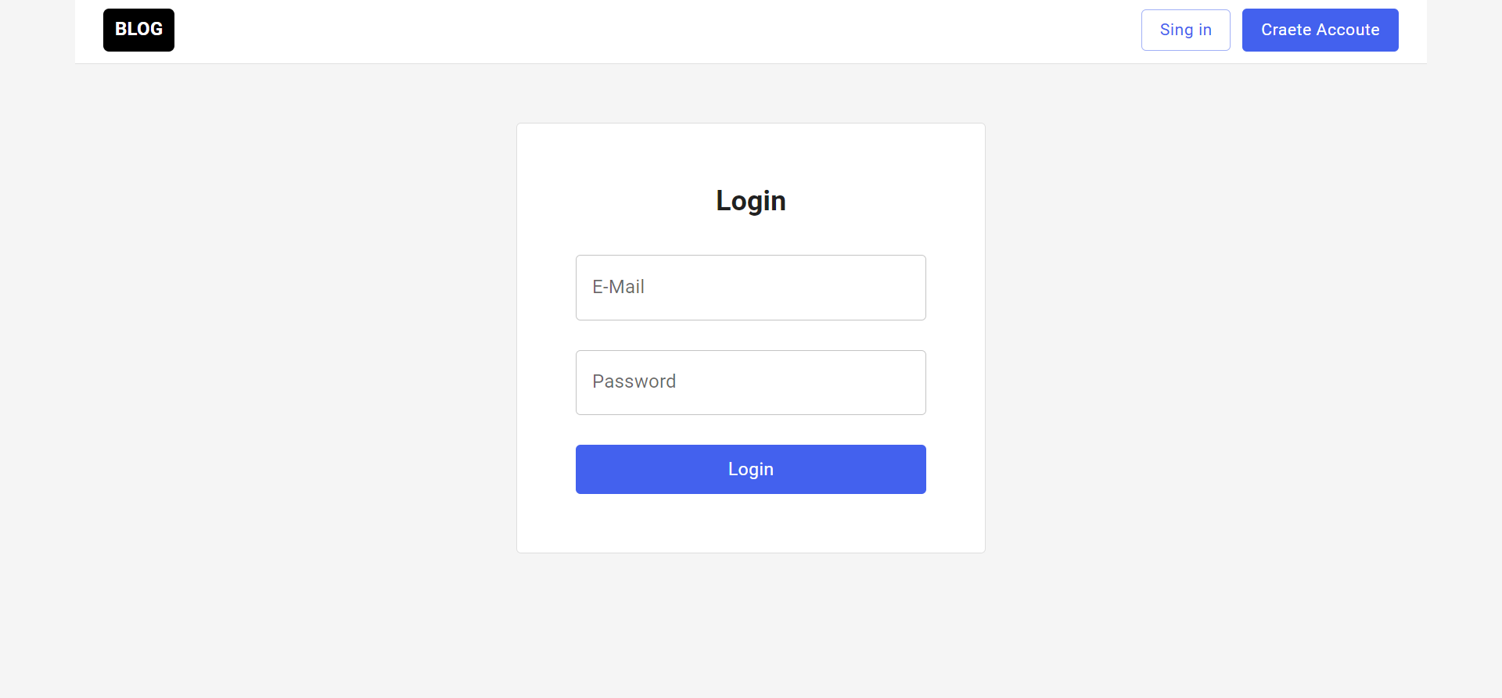
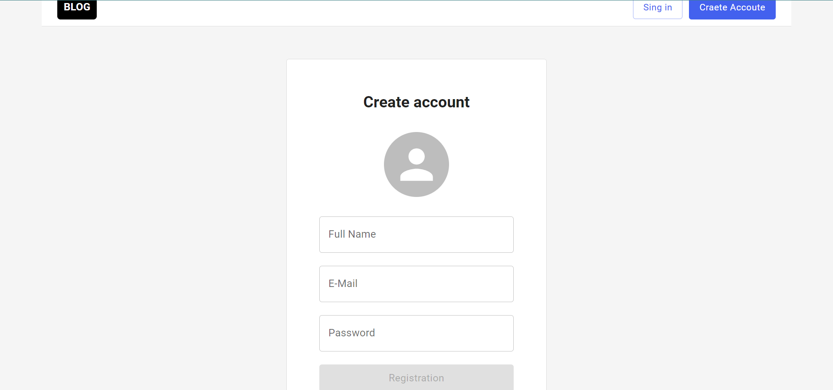
Screenshots
1
1) If you have an account, you can log into your account by entering your data.
2) If you do not have an account, you can create one in the specified form, after which the data will be sent to the database and you will be able to log into your account
2

Slide 7
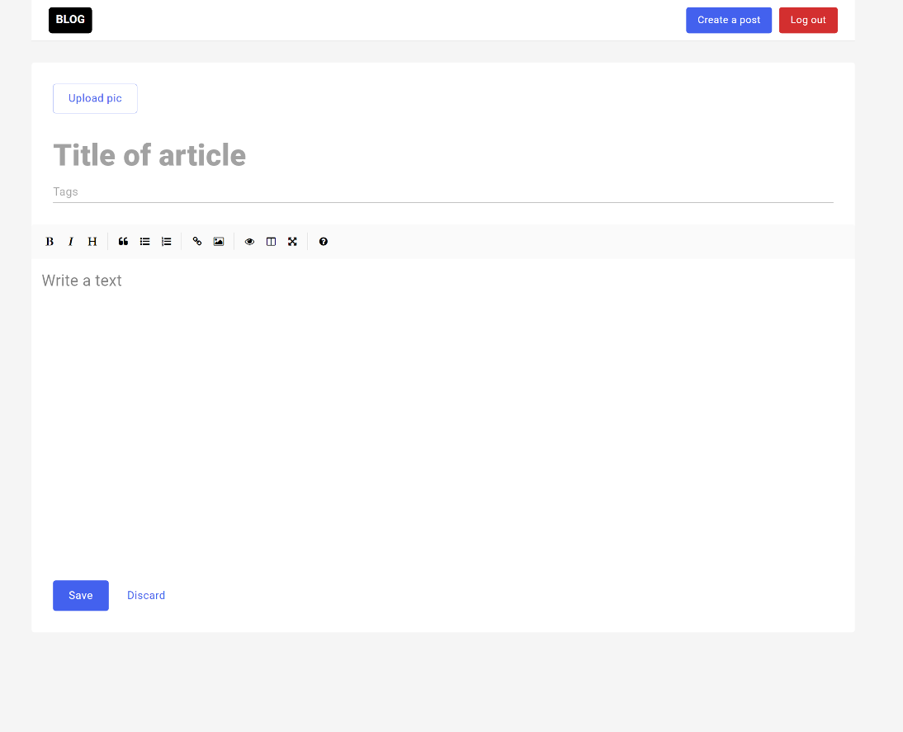
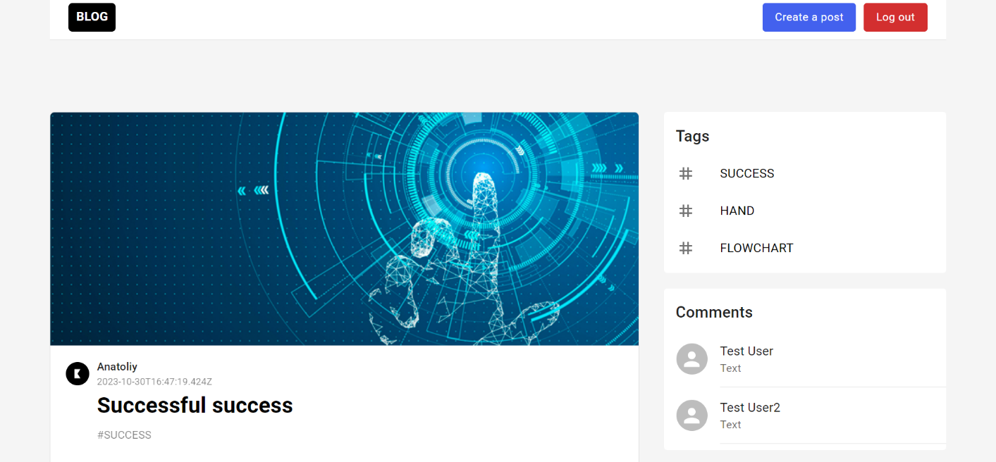
Screenshots
1
2
1)If you logged in you able to create a post or log out.
2) After clicking the "Create Post" button, you will be taken to the "createPost" page where you can write your post with title, tag, text and photo.

Slide 8
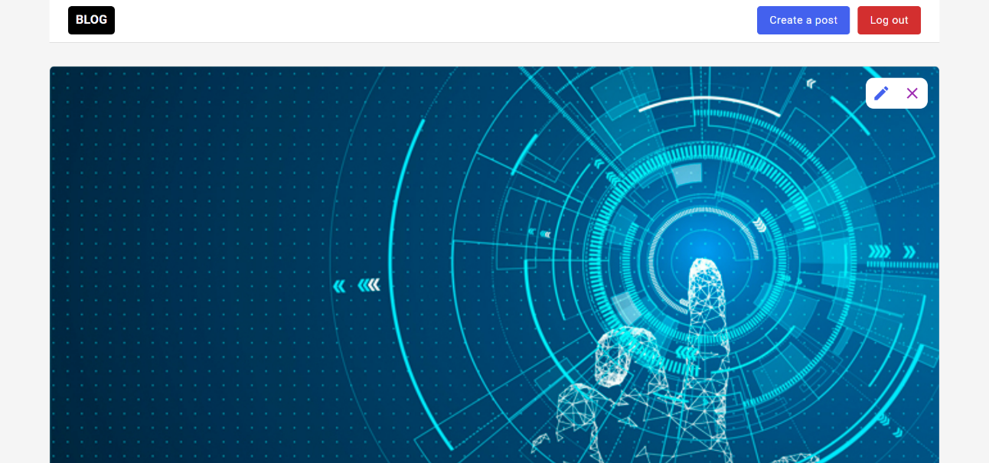
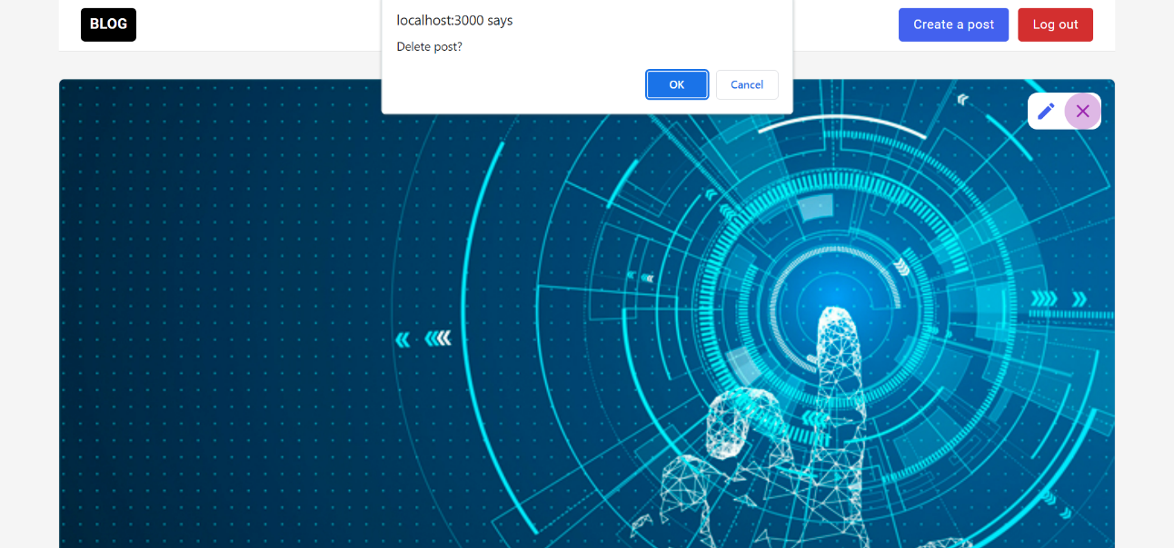
Screenshots
1
1) If you are logged in, you can open the post and on this page, edit the post by clicking the pen button in the right corner, which will take you to the “addPost” page with all the details of that post.
2) You can also delete post by pressing the x button and confirming to delete the message.
2

Slide 9
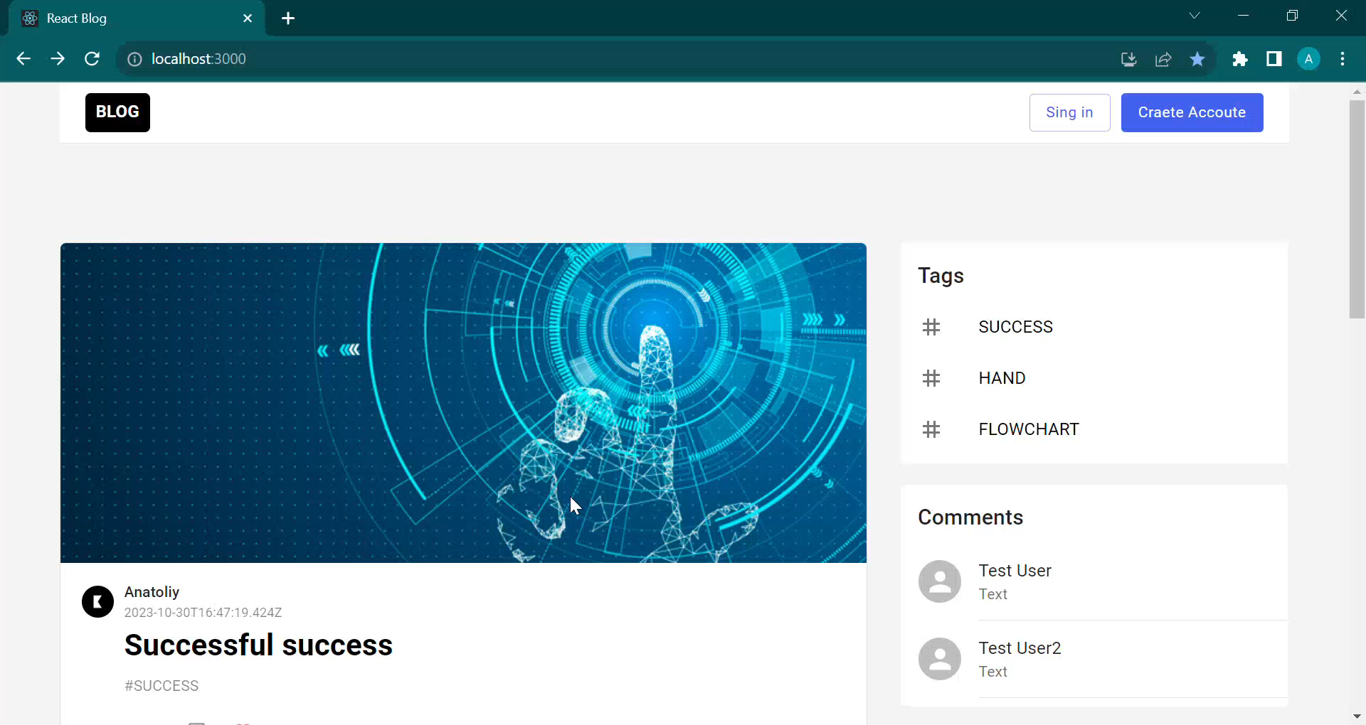
Screencast

